Slide 1
NYPD Shooting Numbers Compared to Police Officer Work Hours and Population Unemployment Rates

Slide 2
NYPD Shooting Data
Data
NYPD Shooting data is a “. . . breakdown of every shooting incident that occurred in NYC. . . ” It is provided by the Office of Management Analysis and Planning and posted to the NYPD website. The data period covers years leading up to the pandemic and the years since. The first step in processing the data was to cleanse it by formatting date fields as date values and then counting the numbers of incidents.

Slide 3
Did Police Officer Work Hours Impact Rates of Shootings?
Police Officer Work Hours Data
This data is available from data.gov (https://catalog.data.gov/dataset/citywide-payroll-data-fiscal-year).
The shooting data is grouped by calendar year and the payroll data is grouped by NYC fiscal year, which is July through June rather than January through December. The data was compared calendar year to fiscal year.
Instead of using head count, a sum of hours worked was used. This was accomplished by summing the total hours (regular plus overtime) grouped for each fiscal year.

Slide 4
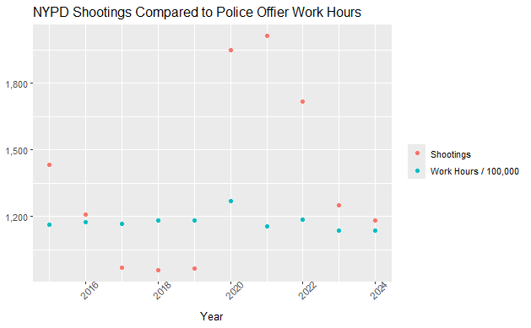
Did Police Officer Work Hours Impact Rates of Shootings?

Slide 5
Did Police Officer Work Hours Impact Rates of Shootings?
Conclusion
Police Officer work hours did not correlate with shooting numbers.

Slide 6
Do Higher Unemployment Rates Cause More Shootings?
Dataset
Data was downloaded from https://www.bls.gov/regions/northeast/data/xg-tables/ro2xglausnyc.htm as “Unemployment Level - Not Seasonally Adjusted”.
The numbers were not summarized as they are summarized in the source of this data.

Slide 7
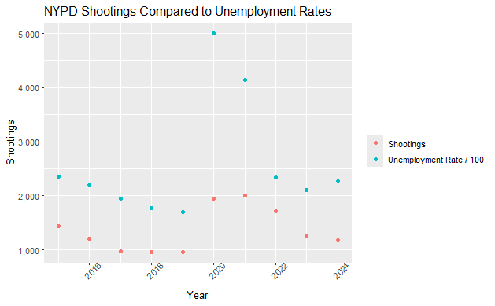
Do Higher Unemployment Rates Cause More Shootings?

Slide 8
Do Higher Unemployment Rates Cause More Shootings?
Conclusion
The unemployment data shows a correlation with shooting numbers but a more detailed analysis would be required to find other factors.

